Slide 1
Some Ways Forward with Trade Barriers
Alan V. Deardorff
Gerald R. Ford School of Public Policy
University of Michigan
For presentation at Renmin University
June 7, 2012, Beijing

Slide 2
Trends in Trade Barriers
70 years ago, trade barriers were mostly tariffs
They had risen and fallen over the decades, and were high – averaging perhaps 40% -- after the Great Depression
Other barriers to trade, if they existed, were not noticed, in comparison with tariffs

Slide 3
Trends in Trade Barriers
At the end of WWII, the winning countries cooperated to create new institutions.
IMF for exchange rates
World Bank for economic development
GATT for trade policies

Slide 4
Trends in Trade Barriers
Under GATT, tariffs were negotiated downward among the developed countries, in a series of Rounds.
Tariffs among developed countries fell from 40% to 4%
New rules began to be adopted to deal with a few nontariff barriers
Developing countries
Did not participate
Eventually saw the wisdom of lowering tariffs unilaterally
Their tariffs remain higher than developed countries

Slide 5
Trends in Trade Barriers
The last completed GATT Round, the Uruguay Round, created the WTO
It includes many things
All of the GATT
Rules on traded services, GATS
Rules on intellectual property protection, TRIPs
Most important, WTO has an improved Dispute Settlement Mechanism, DSM
Countries can files complaints and decisions are enforced
Ultimate sanction is tariffs, but usually not needed

Slide 6
Trends in Trade Barriers
The Doha Round
Begun in 2001, it has faltered and never been concluded
Unclear what will happen, but probably nothing meaningful
What has happened instead
Proliferation of Free Trade Agreements, FTAs
Increased use of nontariff measures, NTMs
Nontariff barriers
Other policies that affect trade (subsidies)

Slide 7
Barriers I’ll talk about
Non-tariff barriers
“Protectionist”
“Assistance”
“Non-Protectionist”
Subsidies
Tariffs, quotas, and tariff-rate-quotas

Slide 8
NTMs and Developing Countries
Note that NTMs may hurt developing countries more than tariffs
Most developed-country tariffs are already low
Many NTMs are hardest on low income countries

Slide 9
My assumptions
Multilateral trade negotiations won’t succeed.
Doha Round may end, with or without claimed success, but it will mean little.
No new round will occur or accomplish anything in foreseeable future.

Slide 10
My assumptions
WTO will remain strong in spite of that, with Dispute Settlement Mechanism (DSM) functioning well.
Proliferation of Free Trade Agreements (FTAs) will continue.

Slide 11
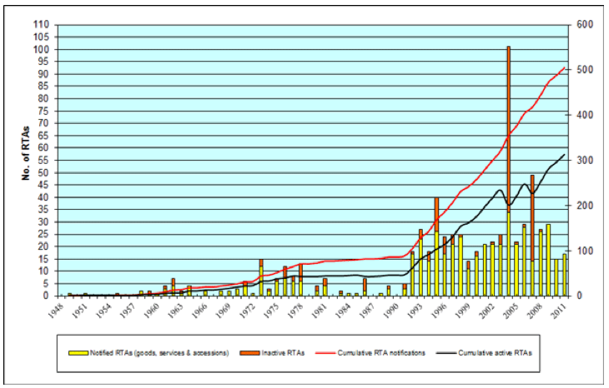
Proliferation of FTAs
Regional Trade Agreements (RTAs) Notified to GATT/WTO
Notes:
http://www.wto.org/english/tratop_e/region_e/regfac_e.htm

Slide 12
Issues to address
What are the barriers?
How are they best dealt with under these assumptions?

Slide 13
“Protectionist” Policies
“Protectionist?”
Policies whose avowed purpose is to help domestic industries at expense of foreign
Types
Tariffs
Import quotas
Export subsidies
Local content requirement
Procurement requirement
Exchange-rate devaluation

Slide 14
“Protectionist” Policies
How to deal with these?
The GATT/WTO was designed to do some of this
Tariff bindings
Prohibitions

Slide 15
“Protectionist” Policies
Aside on VERs = Voluntary Export Restraints
These were “prohibited” by WTO
They may be coming back:
Mar 20: Brazil persuaded Mexico to limit auto exports
Apr 10: Mexico persuaded China to limit footwear exports, to avoid CVD
Who will complain to the WTO?

Slide 16
“Assistance” Policies
“Assistance?”
Policies whose avowed purpose is to help domestic industries
Not explicitly at expense of foreign
But often implicitly at their expense
Types
Domestic subsidies
Bail-outs
Intellectual property protection
Resistance to exchange appreciation

Slide 17
“Assistance” Policies
How to deal with these?
These are harder, as countries reserve the right to provide assistance
Response is to permit other countries to offset any harm to them from these policies, when feasible
E.g., Countervailing duties
This is not always an option, especially for an exporter

Slide 18
“Non-protectionist” Policies
“Non-protectionist?
Avowed purpose is not to help domestic industries
These claim benefit to
Health of people, plants, animals
Environment

Slide 19
“Non-protectionist” Policies
Health and safety examples
Technical Barriers to keep out pests and disease
Geographical indications
Prohibition of genetically modified (GM) organisms
Environment examples
Tuna/dolphin; shrimp/turtle
Carbon tariff

Slide 20
“Non-protectionist” Policies
Distinctive feature:
Simply removing them is not optimal.
That would sacrifice their claimed benefit to health, etc.
Analysis and policy must quantify and respect these benefits, if legitimate.

Slide 21
“Non-protectionist” Policies
Challenges
Evaluating the legitimacy of their non-protectionist purposes
Identifying alternative less discriminatory policies for those purposes
Separating and measuring their protectionist and non-protectionist effects

Slide 22
“Non-protectionist” Policies
Policy heterogeneity
Trade is impacted when countries policies for the same purpose differ
Differences may be accidental
Different standards for the same purpose evolved out of different histories
Trade could be facilitated by
Harmonizing standards, or
Mutual recognition (done recently for US and EU “organic” foods)

Slide 23
“Non-protectionist” Policies
Policy heterogeneity
But differences may also reflect unequal in cost and benefits
Low-income countries may choose lower standard due to cost.
Such differences should be respected, not removed.

Slide 24
“Non-protectionist” Policies
My view
No general methodology will suffice for all such NTMs. Each must be addressed on its own unique merits and demerits.
This is already being done in the WTO DSM.

Slide 25
“Non-protectionist” Policies
My view
DSM is not perfect, but it may be the best we can hope for.
Especially for NTMs that arise anew.
DSM is far better than we might have expected

Slide 26
“Non-protectionist” Policies
DSM
Uses experts on the law
Panel
Appellate Body
Takes evidence from both sides
Should include experts on the substance of any policy
Therefore DSM should be able to do a good job of handling the unique features of each case

Slide 27
“Non-protectionist” Policies
Other options for dealing with these?
FTAs
These can work well for
Harmonizing technical standards
Dealing with necessary standard heterogeneity
Problem
If FTAs center around US and EU, without FTA between US & EU, conflicts may persist between US- and EU-centered regimes
This can be serious for developing countries
Must they choose between US and EU?

Slide 28
“Non-protectionist” Policies
Other options
Plurilateral agreements
Issue-specific agreements, especially including both US and EU, hold promise.
These work best if parties agree on fundamentals
Preventing disease: Yes
Avoiding GM foods: No
These can provide the basis for resolving disputes, even involving non-members
Once they set standards, non-members are likely to join.

Slide 29
Subsidies
Types
On production
On exports
Effects of both: depress world prices
Hurt foreign producers
Help foreign consumers
Nevertheless, they are mostly condemned
except by beneficiaries (farmers)

Slide 30
Subsidies
Can they be ended through negotiations?
Potentially yes, if negotiations are multilateral
But that’s unlikely, given state of Doha Round
Certainly not, if negotiations are bilateral or regional with those harmed
Unlike tariffs, subsidies cannot be removed with respect to only specific trading partners

Slide 31
Subsidies
Can they be ended unilaterally?
Perhaps: “Austerity” makes subsidies an obvious target
Domestic interests should push for agriculture to at least share in the austerity

Slide 32
Subsidies
Why not reduce them?
The political power of farmers
But perhaps they will be mollified if countries don’t do it alone
➔Need to seek coordinated reductions, outside of WTO, by EU, US, and Japan.
Note: This will hurt some poor-country importers. Need to assist them.

Slide 33
Tariffs, etc.
Tariffs remain very high in agriculture and textiles/apparel.
In agriculture, accompanied by quotas and tariff-rate-quotas.
Note that tariff-rate-quotas can be made less harmful by either
Expanding the quota
Lowering the out-of-quota tariff
Thus tariff reduction remains a very important objective.

Slide 34
Tariffs, etc.
That they are high: After Uruguay Round is implemented,
“agriculture and food processing sector will still have twice the average tariffs of textiles and clothing—and nearly four times those for other manufactures.”
(Binswanger and Lutz 2000, drawing on Anderson et al. 1999)

Slide 35
Tariffs, etc.
How can they be reduced?
Multilateral agreement? Not without Doha.
Unilaterally? Not likely, given
Power of protected (esp. farm) interests
Budgetary implications

Slide 36
Tariffs, etc.
FTAs?
Yes, but these only cut tariffs on FTA partners.
Other disadvantages:
Sensitive sectors often excluded.
Tariffs outside remain high.
Even inside, rules of origin (ROOs) may undermine the cuts.

Slide 37
Tariffs, etc.
A suggested alternative: Use FTAs to “Damp” the Tariff Bindings
Specifically, countries should agree to:
Reduce upper limit on all tariffs by the fraction of trade covered by FTAs
As FTAs proliferate, limits on tariffs (tariff bindings) will fall, and eventually tariffs themselves will fall.

Slide 38
Conclusions
Non-tariff measures
“Protectionist”
Already covered by WTO
“Assistance”
Permit CVDs
“Non-Protectionist”
Leave to the WTO DSM.
Negotiate in
FTAs
Plurilateral Agreements

Slide 39
Conclusions
Subsidies
Leave to domestic forces for austerity.
Tariffs, quotas, and tariff-rate-quotas
Harness their reduction to the proliferation of FTAs, via Tariff Damping.

